Slide 1
PRESENTATION ON BAMBOO FODDER WITH COMPARISON TO SORGHUM
The Turning Point
By:
Gladstone Rose & Veronica Gayle

Slide 2
CHARACTERISTICS THAT MAKE BAMBOO SUITABLE FOR FODDER
Bamboo is a super grass offering the opportunity for a more efficient use of land, producing more biomass per unit area than most tree species, hence a greater possibility for continuously available fodder, because:
Easily propagated
Vigorous regeneration capacity
High rate productivity
Fast growth rate
Quick maturity,
Low nutrient and water requirements

Slide 3
CHARACTERISTICS CONT’D
Antioxidant properties
Anti-toxin: Bamboo Charcoal- Eliminates poison after ingestion. Important for counteracting the consumption of moldy feed
Potential use for extending the shelf-life of feed by slowing or retarding fungal growth

Slide 4
LIVESTOCK OF CONCERN
Availability of green fodder during the winter and dry seasons is a growing concern for
Goat
Cattle
The high cost of quality grain, competes with that for human food, therefore a quest for cheaper, more efficient feed ingredients
Pigs
Poultry
Fish

Slide 5
STANDARDS FOR JUDGING FEEDS
Grade of Feed | Minimum CP | ADF | NDF
Prime Feed | >19 | <31 | <40
1 | 17-19 | 31-35 | 40-46
2 | 14-16 | 36-40 | 47-53
3 | 11-13 | 41-42 | 54-60
4 | 8-10 | 43-45 | 61-65
5 | <8 | >45 | >65

Slide 6
Chemical Fraction | Components
Moisture | Water (Volatile acid and base if present)
Crude protein . | Protein, amino acids, amines, nitrates, nitrogenous glycosides, glycolipids, B. vitamins nucleic acid
Ether Extract ( Crude fat) | Fats, oils, waxes, organic acid, pigment, sterols, vitamin A, D, E, and K.
Crude fiber | Cellulose, hemicelluloses, lignin
Nitrogen-free extract | Starch, pectins, organic acid, resins, tannins, pigments, water soluble vitamins
Ash (Mineral matter) | Major elements: Calcium, phosphorus, potassium, magnesium, sodium, sulphur, chlorine. Trace elements: Iron, manganese, copper, cobalt, iodine, zicc, silicon, molybdenum, selenium, chromium, fluorine, vanadium, nickel, tin, Arsenic
Literature Cited | Upreti, 2006

Slide 7
NUTRITIONAL VALUE OF BAMBOO
Protein The major nutritional component of bamboo leaves is carbohydrate, crude fibre and crude protein, altogether constituting approximately 75% of the leaves
Crude Protein, is the most important criterion for judging feeds and fodder and ranges from 9-19% in bamboo leaves

Slide 8
DRY MATTER
Dry matter is what remains after all of the water is evaporated out of a feed: grain and fresh or dried forages.
Dry matter content of a feedstuff is important because it reveals the actual amounts of various nutrients available to the animal consuming the feed, these are:
Crude protein
Ether extract (Crude fat)
Nitrogen-free extract
Crude fiber
Ash /Mineral matter

Slide 9
APPROXIMATE CHEMICAL FRACTION OF BAMBOO
Total Dry Matter: 42%
Crude Protein: 18%
Ether Extract/Crude Fat: 1%
Crude Fibre: 23%
Total Ash: 6%
Moisture: 58%

Slide 10
VARIATIONS IN NUTRIENT VALUES
Differences in nutrient levels due to factors such as:
Soil Composition: Fodders grown on soils efficient or deficient in macro and micro elements provide similar levels to the plants.
Manure and Fertilize Usage: Fertilizer increases the nitrogen content (CP) of the plants.
Irrigation increase in supply of water to the plants, increases the absorption of minerals, particularly calcium.
Stage of Growth: Different stages of growth of the plants have different status of the nutrients (CP, carbohydrate, minerals and vitamins), e.g. younger plants have higher CP content and vice versa.

Slide 11
USABLE PARTS OF BAMBOO SUITABLE FOR FODDER
Leaves
Culm
Shoots
Bi-products from Bamboo Processing

Slide 12
METHODS OF FEEDING BAMBOO
Grazing
Zero-Grazing (Cut and Carry)
Supplement Feeding
Substrate Feeding

Slide 13
SUPPLEMENT FEEDING
Using bamboo in any form in tandem with other feeds, forages and grains
Bi-products from bamboo shoot processing
Bi-products from bamboo pulp and paper processing. Lignin sulfonates as the sugar solution necessary to make the supplement

Slide 14
SUBSTRATE FEEDING
Substrate feeding involves using bamboo part or whole to complement the use of other feeds or organisms or plant species
Benefits: increased nutrient digestibility and availability to the animals
Forms:
Bamboo charcoal added to feed or water
Culm powder added to other ingredients at different ratios
Establish bamboo poles in fish ponds and along riverbanks

Slide 15
CATTLE’S RESPONSE TO BAMBOO
Calves: Decrease in infestation levels of Gastro-intestinal worms
Cows: Increase in milk and ghee yield (suggesting milk of a higher fat content)
Young Hydrocyanic acid present making it
Shoots: dangerous even fatal during grazing

Slide 16
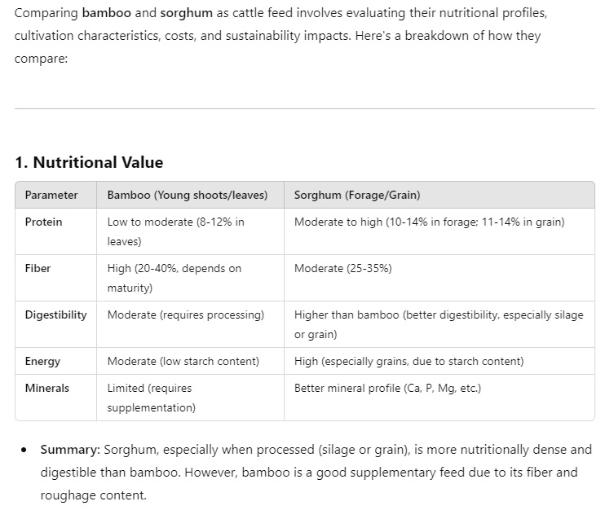
BAMBOO AND SORGHUM

Slide 17
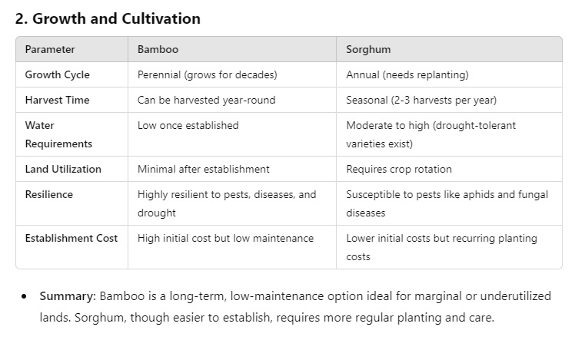
BAMBOO COMPLEMENTS SORGHUM

Slide 18
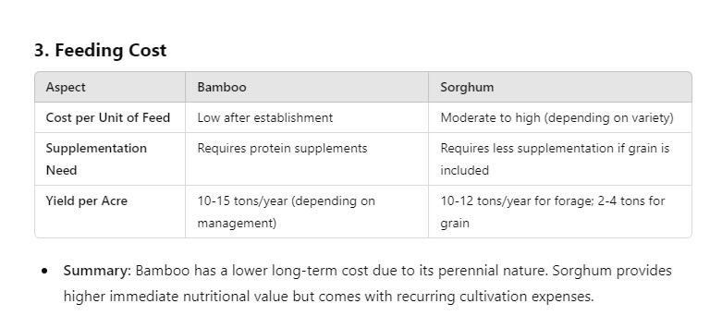
BAMBOO COMPLEMENTS SORGHUM

Slide 19
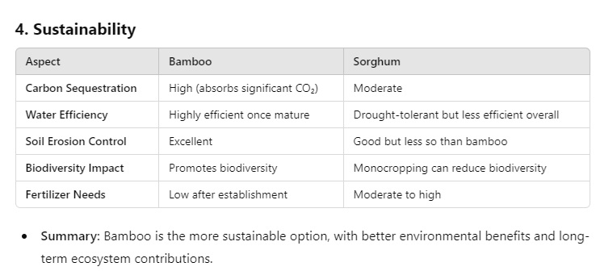
BAMBOO COMPLEMENTS SORGHUM

Slide 20
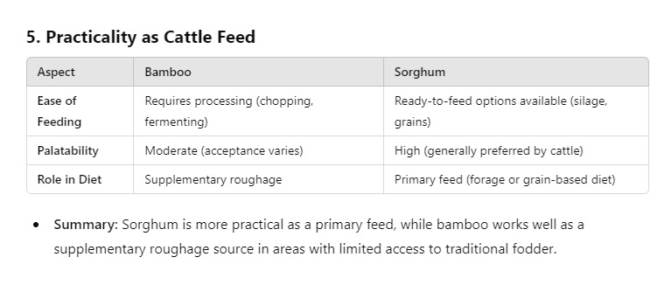
BAMBOO COMPLEMENTS SORGHUM

Slide 21
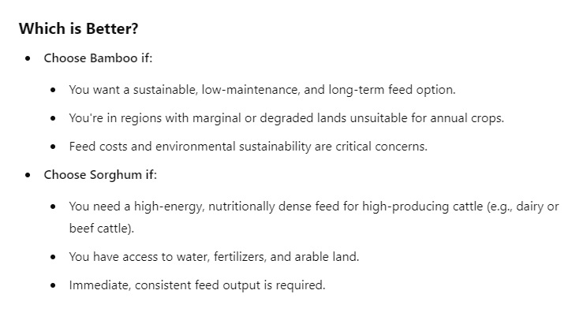
BAMBOO VERSUS SORGHUM

Slide 22
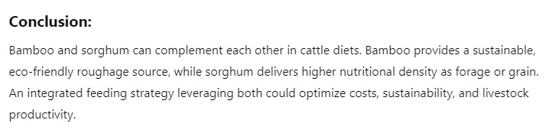
BAMBOO COMPLEMENTS SORGHUM

Slide 23
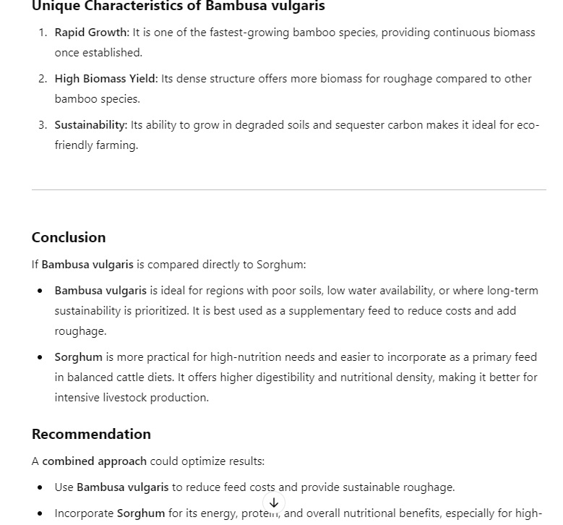
BAMBUSA SPP COMPLEMENTS SORGHUM

